Slide 1
Analysis of GCP Hosted Biomedical Research Abstracts
BAN-675 Final Project
Team 4:
Subramanian Padmanabhan
Prathamesh Rajiv Bhople
Dalton Williams (dwilliams129@horizon.csueastbay.edu)
Date: December 2nd ,2021

Slide 2
Project Background
“BREATHE is a large-scale biomedical database containing entries from 10 major repositories of biomedical research. Our dataset contains both abstract and full body texts of biomedical papers going back for decades and contains more than 16 million unique papers. This dataset can be used to train language models to better understand outcomes from biomedical research and uncover insights to combat the COVID-19 pandemic.” - Google Cloud Platform, BREATHE Description
The purpose of this project is to develop topic modeling based on the abstracts of these biomedical papers, model the topic distribution, concentration, and similarity, and to compare different variations of the models.

Slide 3
Data Description
BREATHE database contains publication dates, abstracts, and the full text of more than 16 million individual research papers, hosted on the Google Cloud Platform.
After extracting all 10 repositories within this database, over a publication time period of about 3. 5 years, nearly 20 Gigabytes worth of CSVs containing abstracts remained.
Randomly sample to reduce the information analyzed to approximately 1000 abstracts, chosen by a uniform random distribution iterating through all of the .CSV files and outputting a single file containing only abstract text.

Slide 4
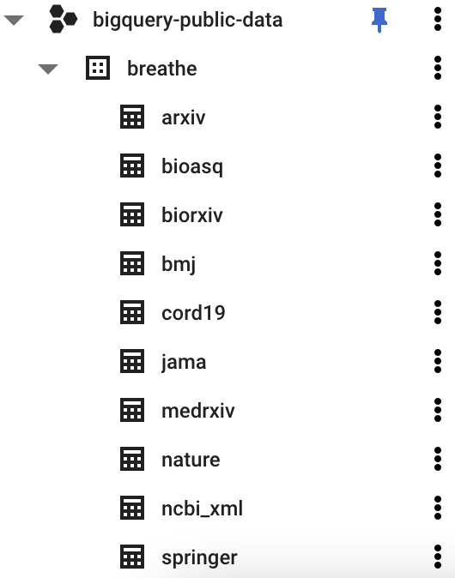
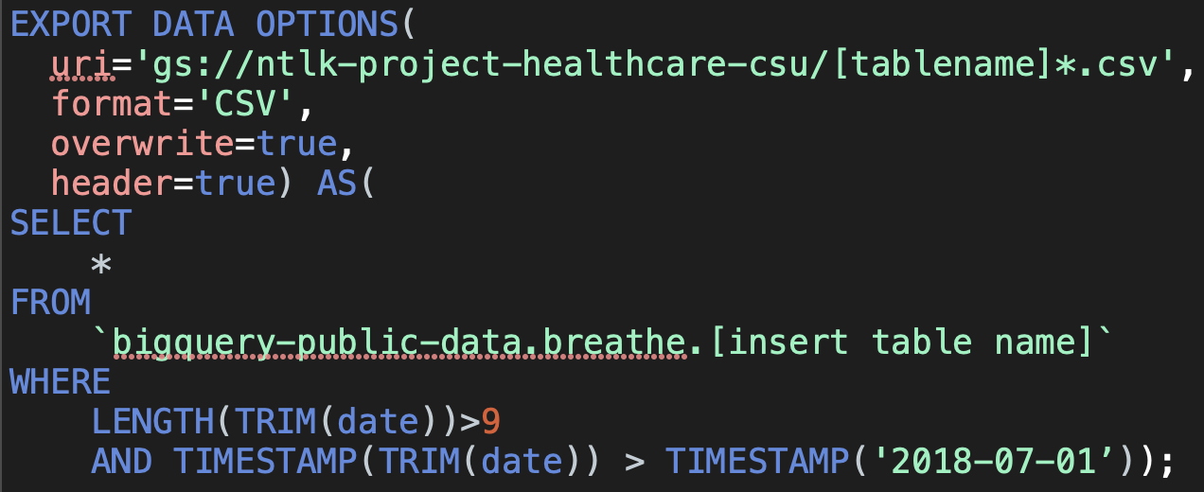
GCP Query Example

Slide 5
Data Pre-Processing
Chose a uniform-random distribution of rows from each file to reach the desired sample of >=1000 documents
Removed Stopwords, URLs with RegEx, non-alphabetic, and least common words
Stemming with PorterStemmer

Slide 6
Research questions
Topics + concentration & similarity
Model optimization w/ gensim vs arbitrary model
Interpreting the similarity between articles after computing cosine similarity
Impact of similar words in different topics helping build good cosine similarity
Do any other models perform better than Regular LDA model
Recommending articles based on an arbitrary abstract

Slide 7
Why is the project useful/important? What are the implications of the research?
Increase the understanding & collaboration of topics of medical research papers
Building Similarity between articles which are an issue nd help find solutions
Project will be beneficial for diverse set of medical journals that has different data
Use of Standard and proven metric to build more informative models
Time saving and economical process resulting in clinical information
Better interchange of ideas supporting future research

Slide 8
Methodologies required to complete the analysis
Gensim - Coherence Model & LDA Model
Topic Analysis
Stemming with PorterStemmer
Text substitution with RegEx
Wordclouds
GoogleSQL Queries in GCP/BigQuery
Uniform Random Distribution
Plotting
Frequency Distribution
Cosine Similarity

Slide 9
Summary statistics
Optimization for the highest coherence score & lowest perplexity resulted in 7 topics
Similarity scores between articles in the sample were determined using the Top 5 topics’ Cosine Similarity scores per article
Topic concentration in each document had an impact while Recommending similar articles
1000+ articles with 1000 passes and batch size of 10 was run for analysis
Total of 8847 unique words were present
Cosine Similarity between certain Articles were 99% and above
Multicore LDA model performs better than regular LDA model in terms of runtime

Slide 10
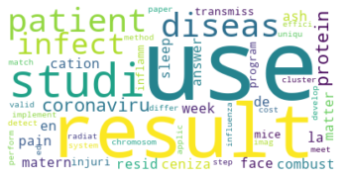
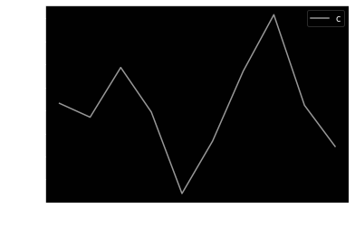
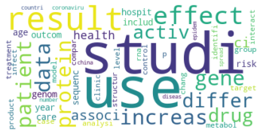
Model Optimization
Wordclouds - Most Representative
Words in an Arbitrary Model (Top)
vs. Optimized Model (Bottom)
Coherence Model Plot

Slide 11
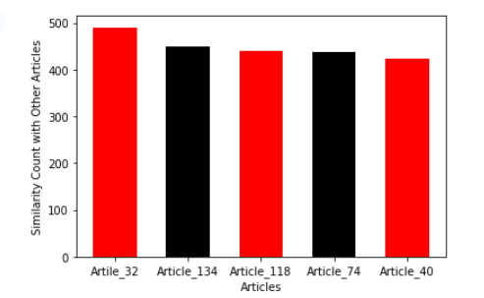
Analysis result report and explanation
Multicore LDA Model of topics size: 7 built a comprehensive dataset
Top 2 Articles has similarity with 450+ other Articles
Topic 4 & Topic 5 had the highest weight distribution
Words like “cell”, “protein”, “infect” & “disease” had highest weights
Most Similar Articles had similar Topics with highest weight
Some Similar articles had different Highest weights for Topics

Slide 12
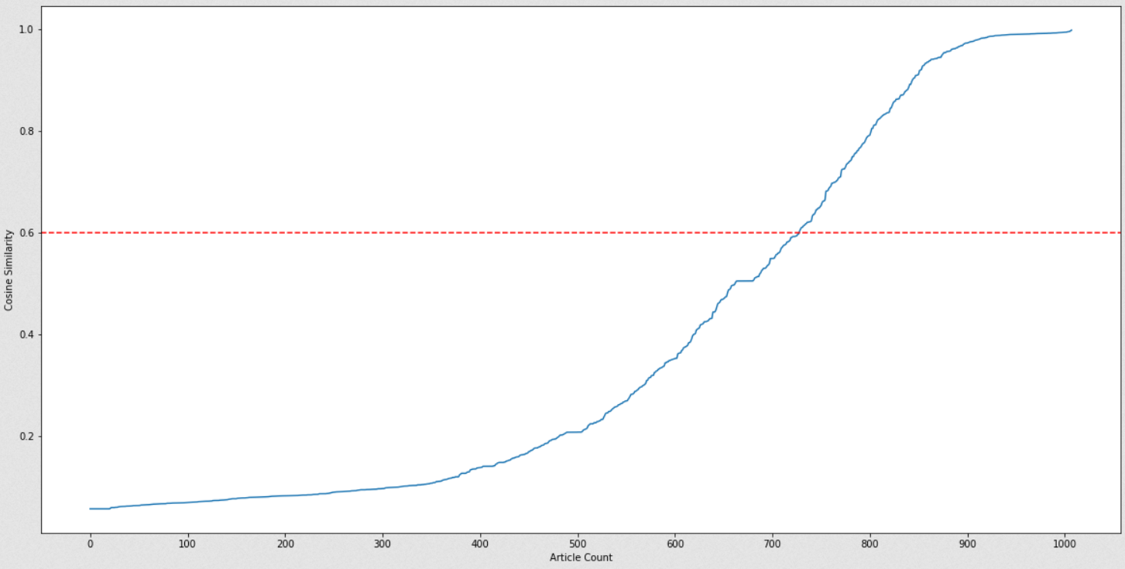
Analysis and Recommendations based on an Arbitrary Abstract
“An outbreak of respiratory disease caused by a novel coronavirus is ongoing till December 2019. As of March 16 2020, It has caused an epidemic outbreak with more than 1,79,073 confirmed infections and 7,074 reported deaths…”
280 articles pass the similarity threshold (0.6) for recommendation.
Scores of top 5 similar articles [0.9946168022626186,0.9949502689017041, 0.9951465384643405,0.9965851992743664, 0.9977934790987246]

Slide 13
Thank You !

